Slide 1
Deep Learning recommendation system
By Gordonov Nikita, Ishmuratov Sergey, Dmitry Kaminskiy, Dmitry Karasev

Slide 2
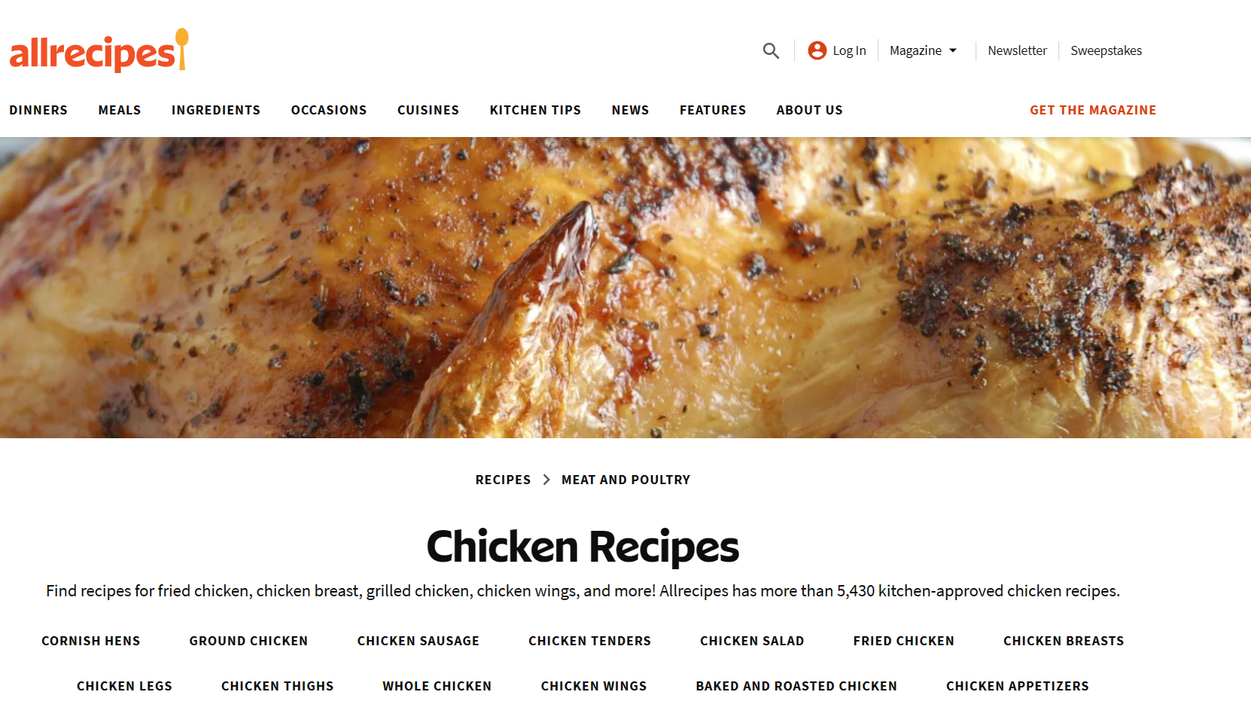
Overview
Dataset:
-AllRecipes.com dataset from HW4
Main idea:
-Logistic and kNN models are simple, so they can’t find some sophisticated patterns in data
Type of problem: Predictive

Slide 3
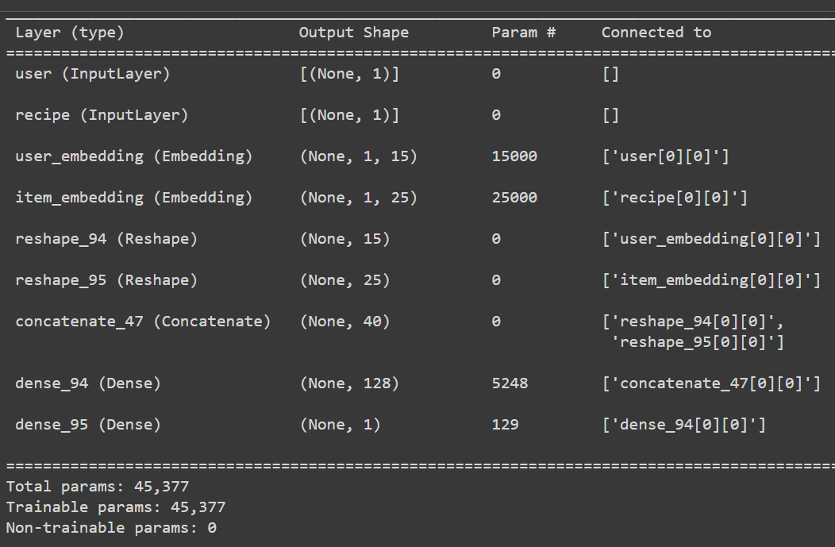
Architecture

Slide 4
(item_id, user_id)
Embedding(item_id)
Embedding(user_id)
Concatenation
Fully connected layers
Prediction

Slide 5
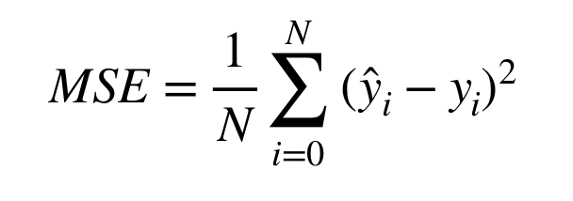
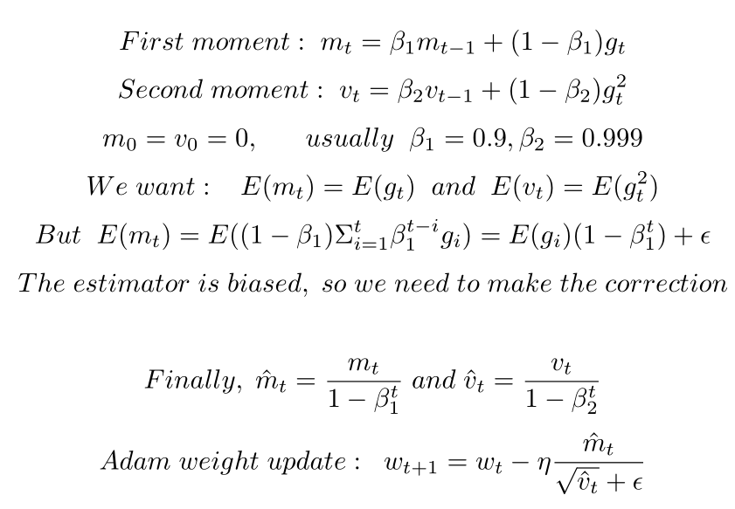
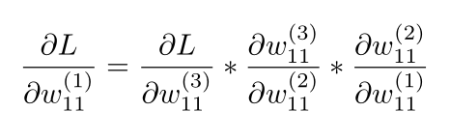
Math background
Loss function - MSE
Optimizer - Adaptive moment estimation (ADAM), works better than SGD
Backpropagation

Slide 6
Hyperparameter tuning
Totally 18 models were evaluated in the Grid Search
-Tuning embedding space size
-Tuning hidden layer params

Slide 7
Best model results (predict all test values)
Accuracy: 0.88329
Precision: 0.12224123182207014
Recall: 0.5033462486791124
F1: 0.1967100282194232
MSE: 0.11671
RMSE: 0.3416284531475679
Already better than kNN and Logit

Slide 8
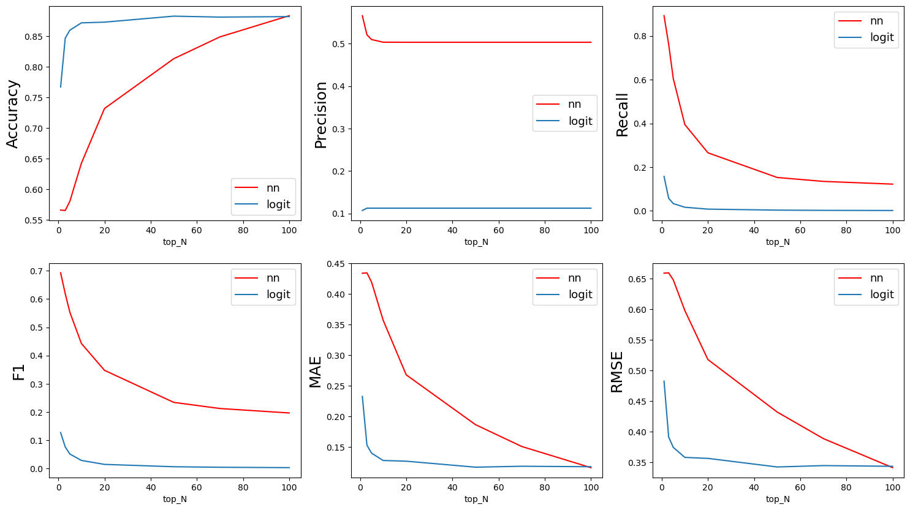
Top-N metrics

Slide 9
Results
It looks like the patterns in data cannot be described by simple model
DL model get a better F1 score, which is the most important metric in the business sense
However, some metrics are worse
DL model is less interpritable
Tuning DL model spends more time than tuning KNN or Logistic regression

Slide 10
Questions?

Slide 11
Sources
https://keras.io/api/layers/
https://www.kaggle.com/code/morrisb/how-to-recommend-anything-deep-recommender
https://towardsdatascience.com/modern-recommender-systems-a0c727609aa
https://towardsdatascience.com/adam-latest-trends-in-deep-learning-optimization-6be9a291375c

